Slide 1

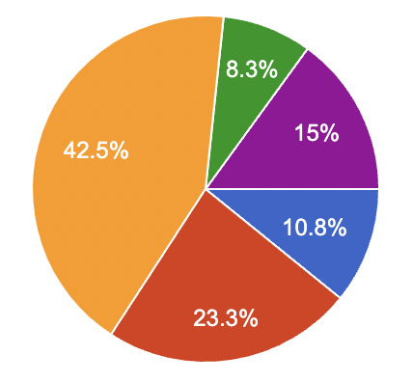
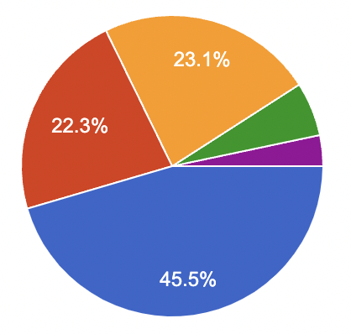
QUALITY OF LIFE, PHYSICAL ACTIVITY AND DIETARY BEHAVIOR OF ACADEMICS DURING THE PANDEMIC PERIOD
Dinu Țurcanu¹, Rodica Siminiuc¹, Vladislav Reșitca ¹, Aurica Chirsanova ¹
Technical University of Moldova, Republic of Moldova.
ENTER YOUR TITLE
INTRODUCTION
In addition to the large number of victims, the COVID-19 pandemic represents an unprecedented challenge with profound social and economic consequences. Loss of regular routine and reduced social and physical contact with others has been shown to frequently cause boredom, frustration and a sense of isolation from the rest of the world. Over the centuries, education has been hit by several challenges. The pandemic has affected all education systems around the world, leading to widespread closures of educational institutions, thus affecting not only students but academics as well. The stress to which academics were subjected can have consequences on occupational health and quality of life, due to negative eating behaviors and lack of physical activity. Meanwhile, research on the effects of pandemic restrictions on teachers is limited.
The aim of the study was to evaluate the quality of life, physical activities, and dietary behavior of university staff during the pandemic.
Figure 1. Interference of physical health and emotional problems with usual social activities, with family, friends, neighbours?
Figure 2. The influence of pain on your studies/usual activities (including both work outside the home and household chores)
For 10.8% (n = 13) of academics, physical health and mood had no impact on usual social activities, and for 42.5% (n = 51) the impact was moderate.
Most of the respondents 67.8% (n = 82), in the last four weeks before participating in the survey, carried out their usual teaching and research activities, without presenting symptoms of pain or physical discomfort.
CONCLUSIONS
The results of this study could be used to study the behavioral phenotype associated with obesity risk. And the strong connection between nutrition and the immune system only heightens the imperative of this study. At the same time, the results could be used in further research to help develop strategies to help promote health security of academics and shape responses to the inevitable future pandemics.
METHOD
This study aimed to analyze the food behavior of UTM employees during the pandemic. A study was conducted, based on the questionnaires Adult Eating Behavior Questionnaire (AEBQ), on a group of UTM employees (n = 121). The respondents completed the questionnaire on the Google platform between in the period 13.10.2021 - 25.11.2021, and the final database has been downloaded as a Microsoft Excel file. The results of the survey were analyzed using the descriptive statistics. The Cronbach’s alpha coefficient was calculated to determine the full reliability of the questionnaire.
ACKNOWLEDGMENTS
The research was carried out within the state project Personalized nutrition and intelligent technologies for my well-being, PS nr. 20.80009.5107.10 and within the postdoctoral grant Contributions regarding nutritional eradication of gluten consumption diseases, nr. 21.00208.5107.06 / PD. Thanks and appreciation to the administration and employees of UTM for their support and involvement.
RESULTS AND DISCUSSIONS
REFERENCES
Alves Durães, S., das Graças Pena, G., Neri Nobre, L., Handyara Bicalho, A., Ramos Veloso Silva, R., Sant’Ana Haikal, D., Amaral Oliveira Rodrigues, C., Fagundes Silveira, M., Santos Figueiredo Brito, M. F., Fonseca Bastos, V., & de Pinho, L. (2021). Food consumption changes among teachers during the COVID-19 pandemic. Obesity Medicine, 26, 100366. https://doi.org/10.1016/j.obmed.2021.100366
Siminiuc, R., Covaliov, E., Țurcanu, D., Pojar, D., Reșitca, V., Chirsanova, A., & Capcanari, T. (2022). Eating Behavior of Students at the Technical University of Moldova during the Isolation Period. Food and Nutrition Sciences, 13(02), 108–123. https://doi.org/10.4236/fns.2022.132011
Țurcanu, D., Siminiuc, R., & Bostan, V. (2020). The Impact of the COVID-19 Pandemic on the Use of Digital Technologies in Ensuring the Efficient e-Learning Process at the Technical University of Moldova. Creative Education, 11(10), 2116–2132. https://doi.org/10.4236/ce.2020.1110154
Țurcanu, D., Siminiuc, R., Bostan, V., & Țurcanu, T. (2022). Impact of the Covid-19 Pandemic on the Use of Microsoft 365 and Learning Outcomes at the Technical University of Moldova. In I. Tiginyanu, V. Sontea, & S. Railean (Eds.), 5th International Conference on Nanotechnologies and Biomedical Engineering (Vol. 87, pp. 456–462). Springer International Publishing. https://doi.org/10.1007/978-3-030-92328-0_59
General aspect. 34.7 % women and 65.3% men participated in the survey. 47% of respondents, at the stage of completing the questionnaire, already had Covid-19, and 19.8% stated that social activities were affected by physical health or emotional problems.
Physical activity. The results showed no difference between the frequency of physical activities before the pandemic and after the pandemic: about 30% (n = 36) practiced intense physical activities 2-3 times per week for about 1-2 hours per day.
Life quality. The majority of teachers 84% (n = 102) considered that they have an average to very good quality of life, and respectively 81.8% (n = 99) valued the same quality of life, but until the pandemic.
International Conference on Gastronomy, Food and Nutrition (ICGaFoN)
www.icgafon.net

